Slide 1
Introduction to Digital Electronics

Slide 2
Lecture 10 Digital Codes
Lecture delivered by:
Deepak V.

Slide 3
Objectives
At the end of this lecture, student will be able to:
Describe complements
List various complements
Acquire the knowledge of Signed binary numbers

Slide 4
Topics
Complements
Diminished Radix Complement
Radix Complement
Signed Binary Numbers

Slide 5
Complements
Complements are used in digital computers to simplify the subtraction operation and for logical manipulation
There are two types of complements for each base-r system: the radix complement and diminished radix complement
1. Diminished Radix Complement - (r-1)’s Complement
2. Radix Complement

Slide 6
Complements
Diminished Radix Complement - (r-1)’s Complement
Given a number N in base r having n digits, the (r–1)’s complement of N is defined as:
(r^{n} –1) – N
Example for 6-digit decimal numbers:
9’s complement is (r^{n} – 1)–N = (10⁶–1)–N = 999999–N
9’s complement of 546700 is 999999–546700 = 453299

Slide 7
Complements
Example for 7-digit binary numbers:
1’s complement is (r^{n} – 1) – N = (2⁷–1)–N = 1111111–N
1’s complement of 1011000 is 1111111–1011000 = 0100111
Observation:
Subtraction from (r^{n} – 1) will never require a borrow
Diminished radix complement can be computed digit-by-digit
For binary: 1 – 0 = 1 and 1 – 1 = 0

Slide 8
Complements
1’s Complement (Diminished Radix Complement)
All ‘0’s become ‘1’s
All ‘1’s become ‘0’s
Example (10110000)₂
⇨ (01001111)₂
If you add a number and its 1’s complement …
1 0 1 1 0 0 0 0
+ 0 1 0 0 1 1 1 1
1 1 1 1 1 1 1 1

Slide 9
Complements
Radix Complement
The r's complement of an n-digit number N in base r is defined as r^{n} – N for N ≠ 0 and as 0 for N = 0. Comparing with the (r − 1) 's complement, we note that the r's complement is obtained by adding 1 to the (r − 1) 's complement, since r^{n} – N = [(r^{n} − 1) – N] + 1.
Example: Base-10
The 10's complement of 012398 is 987602
The 10's complement of 246700 is 753300
Example: Base-2
The 2's complement of 1101100 is 0010100
The 2's complement of 0110111 is 1001001

Slide 10
Complements
2’s Complement (Radix Complement)
Take 1’s complement then add 1
Toggle all bits to the left of the first ‘1’ from the right
OR
Example:
Number:
1’s Comp.:
1 0 1 1 0 0 0 0
0 1 0 0 1 1 1 1
+ 1
1 0 1 1 0 0 0 0
0 1 0 1 0 0 0 0
0
1
0
1
0
0
0
0

Slide 11
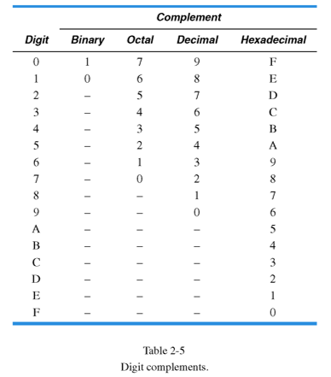
Complements
Table

Slide 12
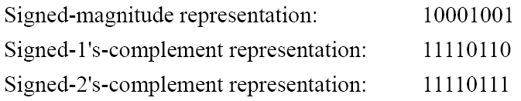
Signed Binary Numbers
To represent negative integers, we need a notation for negative values
It is customary to represent the sign with a bit placed in the leftmost position of the number since binary digits
The convention is to make the sign bit 0 for positive and 1 for negative Example:
Table 1.1 lists all possible four-bit signed binary numbers in the three representations

Slide 13
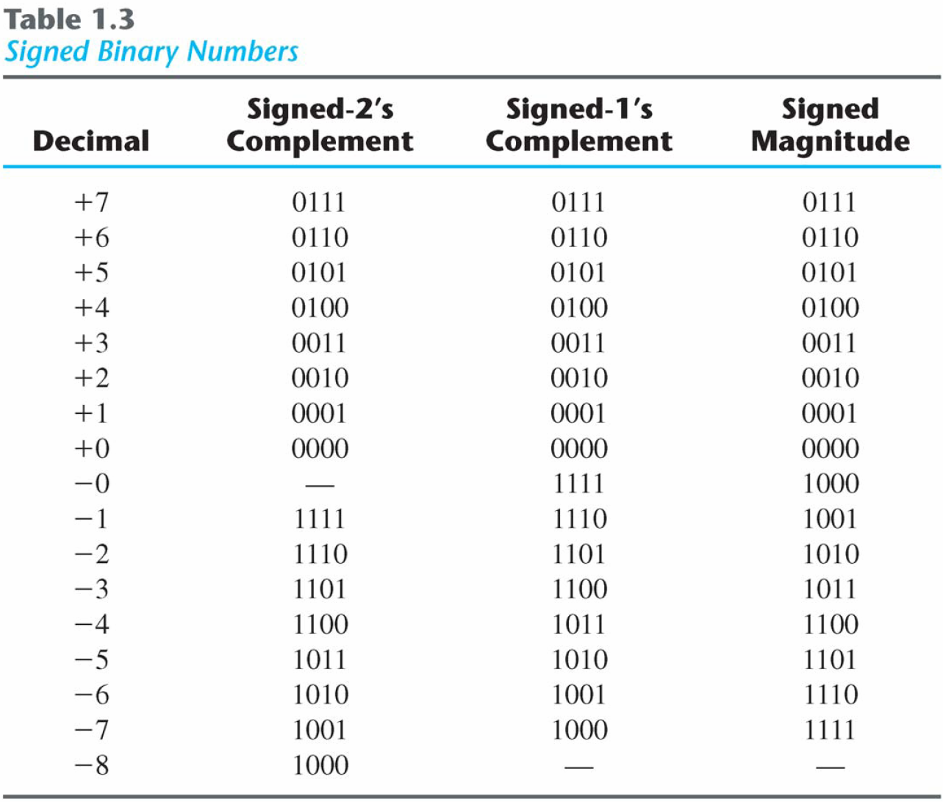
Signed Binary Numbers
Table 1.1 :Signed Binary Numbers

Slide 14
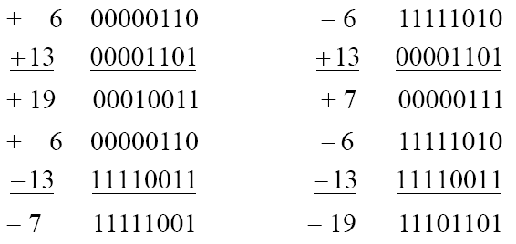
Signed Binary Numbers
Arithmetic addition
The addition of two numbers in the signed-magnitude system follows the rules of ordinary arithmetic. If the signs are the same, we add the two magnitudes and give the sum the common sign. If the signs are different, we subtract the smaller magnitude from the larger and give the difference the sign if the larger magnitude
The addition of two signed binary numbers with negative numbers represented in signed-2's-complement form is obtained from the addition of the two numbers, including their sign bits
A carry out of the sign-bit position is discarded
Example:

Slide 15
Signed Binary Numbers
Arithmetic Subtraction
In 2’s-complement form:
Take the 2’s complement of the subtrahend (including the sign bit) and add it to the minuend (including sign bit).
A carry out of sign-bit position is discarded.
Example:
(− 6) − (− 13)
(11111010 − 11110011)
(11111010 + 00001101)
00000111 (+ 7)

Slide 16
Summary
Complements are used in digital computers to simplify the subtraction operation and for logical manipulation
There are two types of complements for each base-r system: the radix complement and diminished radix complement
The addition of two signed binary numbers with negative numbers represented in signed-2's-complement form is obtained from the addition of the two numbers, including their sign bits.

